Slide 1
Web Applications CT050-3-2 (VD1)
Web Site Design Method (WSDM)

Slide 2
Topic & Structure of The Lesson
Web Development Challenges
WSDM
WSDM Overview
Mission Statement Specification
Audience Modeling
Audience Classification
Audience Characterization
Conceptual Design
Task & Information Modeling
Navigational Design
Implementation Design
Site Structure Design,
Presentation Design and
Logical Data Design
Implementation

Slide 3
Learning Outcomes
At the end of this topic, You should be able to
To discuss the challenges in developing Web site.
To understand the main stages of WSDM.
To apply WSDM model in Web site development.

Slide 4
Key Terms You Must Be Able To Use
If you have mastered this topic, you should be able to use the following terms correctly in your assignments and exams:
WSDM

Slide 5
Web Development Challenges
Software
Engineering
Multimedia
Hypertext
Web Engineering
Human-Computer
Interaction
Information
Engineering
Testing
Requirements
Engineering
Project
Management
Public
Relations
System Analysis
and Design
Based on: Murugesan et al, Web Engineering: A New Discipline for Development of Web-Based Systems, in
“Web Engineering: Managing Diversity and Complexity of Web Application Development, 2001. Page 8

Slide 6
WSDM
Website development approach
Web
Site
Design
Method
Pronounced as wisdom

Slide 7
WSDM Overview
WSDM (Web Site Design Method) is an audience driven design method for Web Applications.
Developed at the Web & Information System Engineering (WISE) research group of the department of Computer Science of the Vrije Universiteit Brussel.
Initiated in 1998 by Prof. Dr. Olga De Troyer, WSDM was among the first web site design methods.

Slide 8
WSDM Overview
Originally aimed at creating kiosk websites, WSDM evolved to a complete semantic web design method, both applying and deploying semantic web technology, and supporting functionality as well as a variety of additional design issues (localization, accessibility, semantic annotation, adaptively, ...).

Slide 9
WSDM Overview
It consists of a five-phase design, taking as a starting an explicit elicitation of the users and ending with the actual implementation (generation).
Mission Statement Specification
Audience Modeling
Conceptual Design
Implementation Design
Implementation

Slide 10
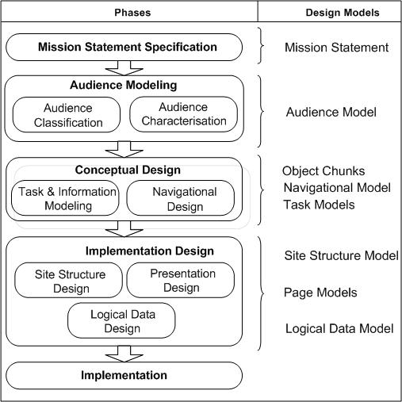
WSDM Overview
http://wsdm.vub.ac.be/Research/overview.php
Notes:
Almost similar phases like Software Development Life Cycle (SDLC) – learned in System Analysis & Design – more focus for web dev

Slide 11
Stage 1 - Mission Statement Specification
The first step in WSDM is to define the mission statement of the web site.
The mission statement must answer the following questions:
what is the purpose of the web site?
What is the subject?
who are the target audience(s)?
In the mission statement, the purpose, the subject and the targeted users of the web site are specified.
The mission statement establishes the borders of the design process.

Slide 12
Stage 1 - Mission Statement Specification
In the rest of the method it will allow to decide what information or functionality to include or not, how to structure the information and how to present it.
In addition, the mission statement is useful for validation, i.e. to check if the web site has achieved the formulated purpose.
The mission statement is formulated in natural language.

Slide 13
Stage 1 - Mission Statement Specification
As an example we give the mission statement for a web site of a typical university department. This mission statement is twofold:
Enhance the communication between students and lecturers by providing detail information about the available courses.
Provide information about the available programs to potential students to attract more students.

Slide 14
Stage 1 - Mission Statement Specification
The target audiences in this example are students, lecturers and potential students.
The purpose is to enhance the communication between students and lecturers and to attract more new students.
The subject is courses and programs.
Note that by this mission statement, the subject of this web site is deliberately limited to teaching information and researchers are not part of the target audiences.

Slide 15
Stage 2 - Audience Modeling
The mission statement formulated in the first phase is only a first and very incomplete description of the system that should be developed.
Because WSDM is an audience-driven design method, the first concern that is elaborated is the set of target users.
WSDM takes into account the fact that different types of visitors may have different needs and requirements, and thus may require different support (e.g., in a university website, 'students' and 'researchers' clearly have different goals and purpose to visit the website).

Slide 16
Stage 2 - Audience Modeling
Therefore, the target users identified in the mission statement are refined into so-called audience classes. This is done by means of two sub phases:
the Audience Classification and
the Audience Characterization.

Slide 17
Stage 2 - Audience Modeling
Audience Classification
During Audience Classification, the different types of users are identified into more detail and classified: users with the same (information and functional) requirements are grouped together into so-called audience classes.
When the set of requirements of a particular audience class is a subset of the set of requirements of another audience class, we call this first audience class an audience subclass of the latter.

Slide 18
Stage 2 - Audience Modeling
Audience Classification
Based on the subclass relationships, the audience classes can be classified into a so-called audience hierarchy, which will later on be used to derive the basic navigational structure (see Conceptual Design).
For each audience class, navigation and usability requirements are stated as well.
An audience subclass thus has the same, and some additional requirements as its audience superclass.

Slide 19
Stage 2 - Audience Modeling
Audience Classification
To identify the different audience classes we look at the activities of the organisation for which the web site is built.
These activities are decomposed in order to refine in each decomposition step the target audience given in the mission statement.
We only consider the activities that are related to the purpose and subject of the web site.

Slide 20
Stage 2 - Audience Modeling
Audience Classification
Each activity involves people. These people are potential users if they belong to the target audience given in the mission statement.
In our university department, example the only activity is “Provide Education”.
Activities such as “Perform Research” and “Advise Companies” are not (directly) relevant for the purpose of this web site.

Slide 21
Stage 2 - Audience Modeling
Audience Classification
In our example, the activity “Provide Education” involves lecturers, enrolled students, potential students and staff members
Activity Diagram “Provide Education”

Slide 22
Stage 2 - Audience Modeling
Audience Classification
In order to check whether we have to refine these audience classes, we check if we can decompose the activity “Provide Education” into sub-activities.
For our university department we can decompose this activity into “Provide Graduate Education” and “Provide Master Education”.

Slide 23
Stage 2 - Audience Modeling
Audience Classification
This result in a new activity diagram:
Decomposition of Activity Diagram “Provide Education”.

Slide 24
Stage 2 - Audience Modeling
Audience Characterization
During Audience Characterization relevant characteristics are specified for each audience class.
Next to the fact that different types of users may have different information and functional requirements, it may be necessary to represent the (same) information or functionality in different ways to different kinds of users.
This depends on the characteristics of the users.

Slide 25
Stage 2 - Audience Modeling
Audience Characterization
If within one audience class we can distinguish groups of members with different characteristics, we introduce audience class variants.
Consider as an example in the university site example the audience class Enrolled Students.
In this class we may distinguish between local students and exchange students.
Both have the same information requirements (detail information on courses) but they have different characteristics and usability requirements.
Two variants: Local Students and Exchange Students.

Slide 26
Stage 2 - Audience Modeling
Audience Characterization
Local Students
Local students are young (between 18 and 28), are familiar with the university jargon, the university rules and customs. They prefer the local language for communication, but have in general a good understanding of English.
Exchange Students
All communication with the exchange students is done in English. We may not presume that they are familiar with the university jargon and customs.

Slide 27
Stage 3 - Conceptual Design
During the previous phases, mission statement specification and audience modeling, the information-, functional-, usability- and navigational requirements as well as the characteristics of the potential visitors were identified and different audience classes are defined.
The goal of the Conceptual Design is to turn these informal requirements into high level, formal descriptions which can be used later on to generate (automatically or semi-automatically) the web system.

Slide 28
Stage 3 - Conceptual Design
During Conceptual Design, we concentrate on the conceptual “what and how” rather than on the visual “what and how”.
The conceptual “what” is covered by the Task & Information Modeling sub phase and deals with modeling of the content and functionality of the web system; the conceptual “how” is covered by the Navigational Design sub phase and specifies the conceptual structure of the web system and the navigation.

Slide 29
Stage 3 - Conceptual Design
Task & Information Modeling
The purpose of the Task & Information Modeling is to model in detail the different tasks the members of each audience class need to be able to perform, and to formally describe the data and functionality that is needed for those tasks.
The tasks that a member of an audience class needs to be able to perform is based on the requirements formulated for the audience class during Audience Classification, i.e. for each information and functional requirement formulated for an audience class, a task is defined that allows to satisfy this requirement.

Slide 30
Stage 3 - Conceptual Design
Task & Information Modeling
Each task is modeled into more details using an adapted version of the task modeling technique Concurrent Task Trees (CTT); originally developed in the context of HCI.
Essentially, in CTT, tasks are decomposed into subtasks until elementary tasks are obtained. In addition, temporal relationships between subtasks allow to indicate the order in which the subtasks need to be performed (e.g. sequential, parallel, etc).

Slide 31
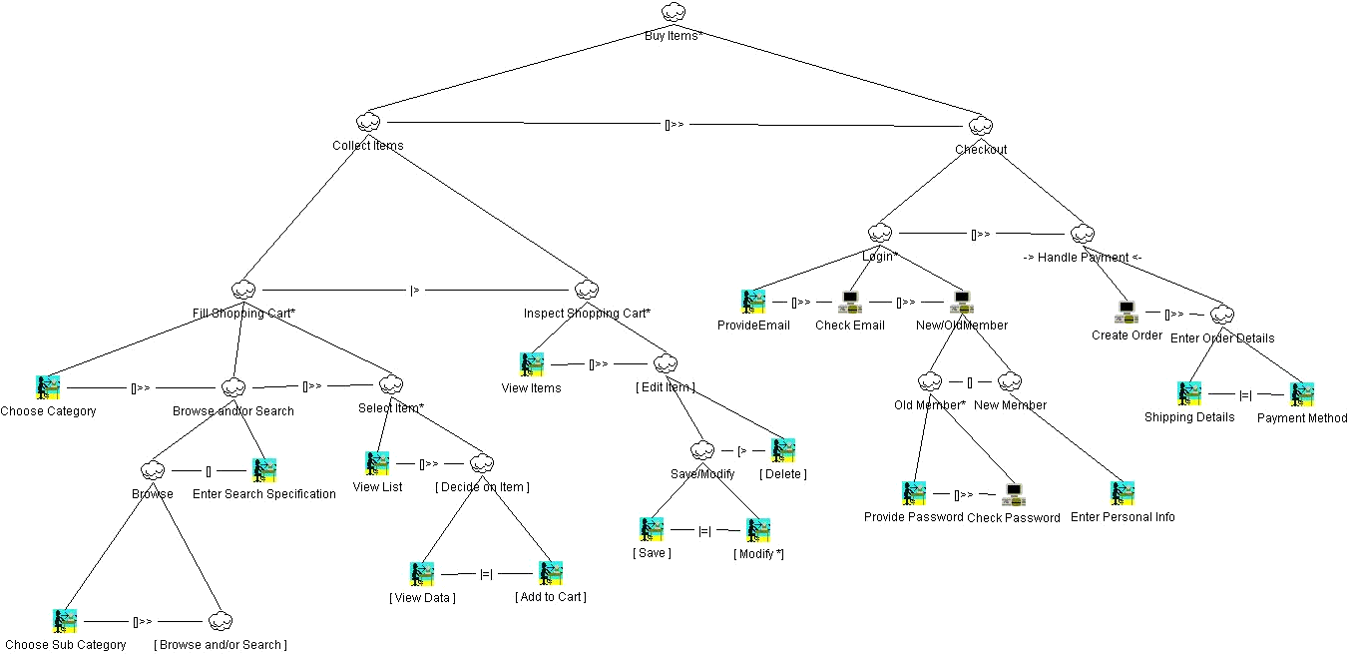
Stage 3 - Conceptual Design
Task & Information Modeling - Concurrent Task Trees
De Troyer, O., Casteleyn, S.: "Modeling Complex Processes for Web Applications using WSDM", Proceedings of the Third International Workshop on Web-Oriented Software Technologies (held in conjunction with ICWE2003), IWWOST2003 (also on http://www.dsic.upv.es/~west/iwwost03/articles.htm), Eds. Daniel Schwabe, Oscar Pastor, Gustavo Rossi, Luis Olsina, Oviedo, Spain (2003)

Slide 32
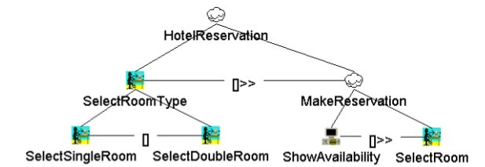
Stage 3 - Conceptual Design
Task & Information Modeling - Concurrent Task Trees
Example of task & information modeling

Slide 33
Stage 3 - Conceptual Design
Task & Information Modeling
Once a task decomposition is completed, each elementary task is modeled by a so-called object chunk.
An object chunk formally describes the information (and/or functionality) needed to complete this task. Initially, Object Role Modeling (ORM) was used for this purpose, but to better suit the needs of the semantic web, WSDM now uses OWL (Web Ontology Language) (with some specific modeling concepts to support functionality).
The use of OWL allows the use of (one or more) existing ontologies, and facilitates the (automatic) generation of semantic websites (see Semantic Annotations), effectively enabling the Semantic Web.

Slide 34
Stage 3 - Conceptual Design
Task & Information Modeling
Object chunk

Slide 35
Stage 3 - Conceptual Design
Task & Information Modeling
Object chunk

Slide 36
Stage 3 - Conceptual Design
Task & Information Modeling
Audience Model (partially)

Slide 37
Stage 3 - Conceptual Design
Navigational Design
The goal of the Navigational Design is to define the conceptual structure of the web system and to model how the members of the different audience classes can navigate through the web system and perform their tasks.
Because of the audience driven approach of WSDM, a navigation track is created for each audience class.
Such an audience track can be considered as a sub-site containing all and only the information and functionality needed by the members of the associated audience class.
A navigational model is created by means of components (also called 'nodes') and links: components are conceptual navigation entities, referring to information/functionality that logically belongs together; link are connections between components.

Slide 38
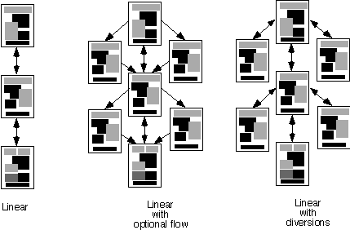
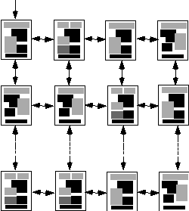
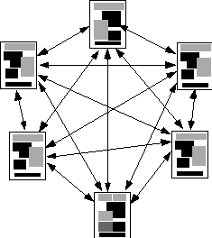
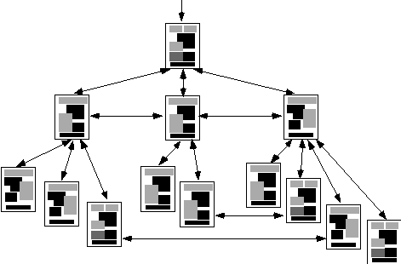
Stage 3 - Conceptual Design
Navigational Design
Linear
structure
Grid
structure
Network
structure
Hierarchical
structure

Slide 39
Stage 3 - Conceptual Design
Navigational Design
Navigation track for Exchange Students

Slide 40
Stage 3 - Conceptual Design
Navigational Design
Navigation track for Potential Students

Slide 41
Stage 3 - Conceptual Design
Navigational Design
Composition of navigation tracks into a navigation model

Slide 42
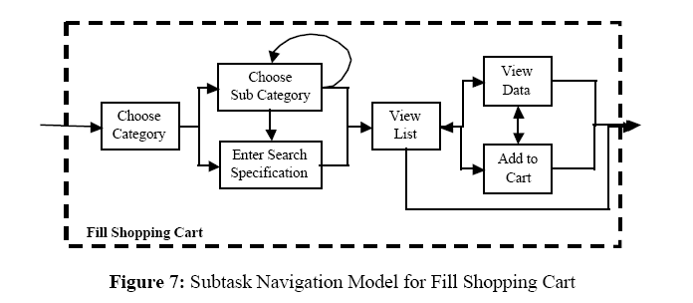
Stage 3 - Conceptual Design
Navigational Design
De Troyer, O., Casteleyn, S.: "Modeling Complex Processes for Web Applications using WSDM", Proceedings of the Third International Workshop on Web-Oriented Software Technologies (held in conjunction with ICWE2003), IWWOST2003 (also on http://www.dsic.upv.es/~west/iwwost03/articles.htm), Eds. Daniel Schwabe, Oscar Pastor, Gustavo Rossi, Luis Olsina, Oviedo, Spain (2003)

Slide 43
Stage 4 - Implementation Design
The goal of the implementation design is to complement the conceptual design with the necessary details for the implementation.
The implementation design consists of three sub phases:
the Site Structure Design,
the Presentation Design and
the Logical Data Design
From the models specified during Conceptual and Implementation Design, an implementation for the chosen implementation platform, can be generated automatically.

Slide 44
Stage 4 - Implementation Design
Site Structure Design
During Site Structure Design the designer decides how the components from the navigational model (information and functionality) will be grouped into pages.
The characteristics, of the different audience classes may be taken into account when deciding which information to group on a page.
By default, one component is assigned to one page, but in general, the designer may group several conceptual navigation components on one page, or split up a component over different pages.
For one conceptual design, several site structures can be created, supporting different device, context or platforms.

Slide 45
Stage 4 - Implementation Design
Presentation Design
During Presentation Design the look and feel of the web system, as well as the layout of the pages (i.e. positioning of page elements) is defined.
To enhance a consistent look and feel, templates are used. Therefore, page templates are defined.
Typically, a web system may require different kinds of pages e.g., a homepage, a title page, leaf page.

Slide 46
Stage 4 - Implementation Design
Presentation Design
For each of those page types a template can be created.
These templates are subsequently used in the page design, when for each of the pages defined in the site structure model the layout is defined.
The layout describes how the information and functionality (modeled by means of the object chunks and) assigned to a page (by means of the components) should be laid out on the page.

Slide 47
Stage 4 - Implementation Design
Presentation Design
For both the template and page design a number of presentation modeling concepts are available.
To position information, the concept of a grid is used. A grid contains rows with cells.
Absolute and relative height and width can be specified for grids, rows and cells.

Slide 48
Stage 4 - Implementation Design
Presentation Design
Next to this (low-level) positioning mechanism, WSDM also provides higher-level presentation concepts (e.g., menu, table, bulleted-list), which are more powerful and intuitive for the designer to use.
To specify style, WSDM currently relies on Cascading Style Sheets (CSS).

Slide 49
Stage 4 - Implementation Design
Presentation Design
Also during presentation design, the designer decides on the labels to be used for the navigation defined during the navigational design.

Slide 50
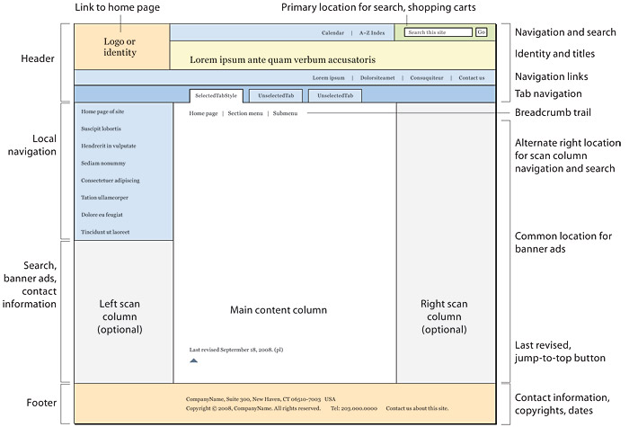

Slide 51
Stage 4 - Implementation Design
Logical Data Design
In case no data storage is already available, a logical data schema needs to be created from this conceptual schema.
This is comparable to the creation of a relational database schema from a conceptual ER schema or UML schema.

Slide 52
Stage 4 - Implementation Design
Logical Data Design
In this sense, objects chunks can be seen as views on the reference ontology that is incrementally constructed during Information Modeling.
The reference ontology may be based on one or more existing (external) ontologies or created from scratch.
It can be considered as the conceptual schema for the data to be provided by the web site.

Slide 53
Stage 4 - Implementation Design
Logical Data Design
In case no data storage is already available, a logical data schema needs to be created from this conceptual schema.
This is comparable to the creation of a relational database schema from a conceptual ER schema or UML schema.
The logical data schema can be a relational database schema, an XML schema, an RDF schema or even the OWL schema of the reference ontology itself.

Slide 54
Stage 4 - Implementation Design
Logical Data Design
While generating the logical data schema, it is important to keep track of the mapping between the reference ontology and the logical data schema, because later on (in the implementation phase ) the conceptual queries and updates expressed in the object chunks need to be translated into queries and updates onto the logical database schema.
By preference, this process is supported by a CASE-tool, in which case the designer is not burdened with the creation of the logical data schema and the mappings.

Slide 55
Stage 4 - Implementation Design
Logical Data Design
In a second scenario, an existing data store is available. In this case it is only needed to define the mapping between the reference ontology and this data store.

Slide 56
Stage 5 - Implementation
The actual implementation can be generated automatically from the information collected during the different design phases by means of the different design models (i.e. navigational model, site structure model, page models, logical data models and mappings).

Slide 57
Stage 5 - Implementation
As a proof-of-concept, two implementation archtectures have been set up: a transformation pipeline (using XSLT), and a more dynamic server-side architecture (using Java).
The XSLT transformation pipeline takes as input the object chunks (with corresponding data source mapping), navigational-, site structure-, style & template- and page models, and outputs the actual implementation for the chosen platform and implementation language.
This transformation is performed fully automatically.

Slide 58
Stage 5 - Implementation
The server-side architecture reacts, in real-time, on page-requests (by the user) and builds the requested page on-the-fly. Although this implementation is more complex, is does allow for extra functionality (e.g., tracking of events for adaptative behaviour, see Adaptivity).

Slide 59
Summary

Slide 60
Summary

Slide 61
Quick Review Question
Define a Web site’s mission statement based on your assignment title.
Identify the audience classes of you Web site.

Slide 62
Summary of Main Teaching Points
Phases of WSDM

Slide 63
Question and Answer Session
Q & A

Slide 64
What we will cover next
Accessibility

